Slide 1
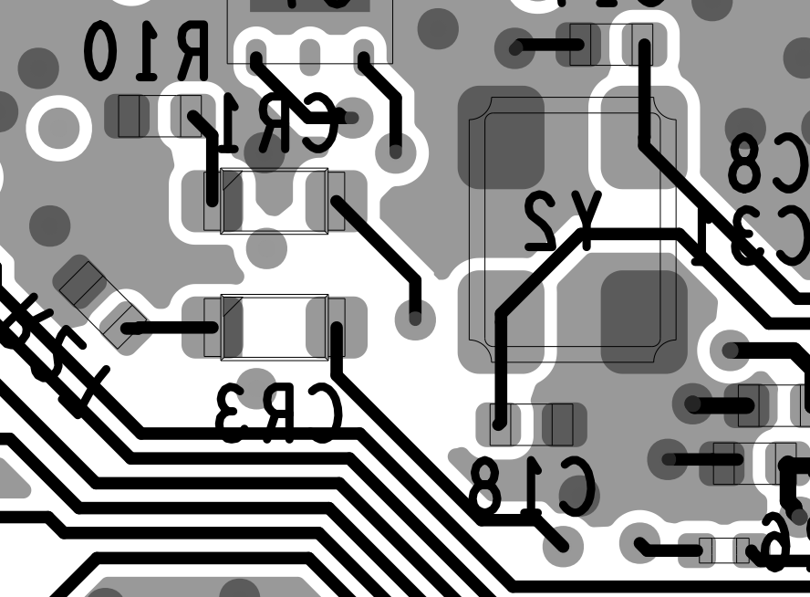
resistor
ground plane
RED LED
connect here

Slide 2
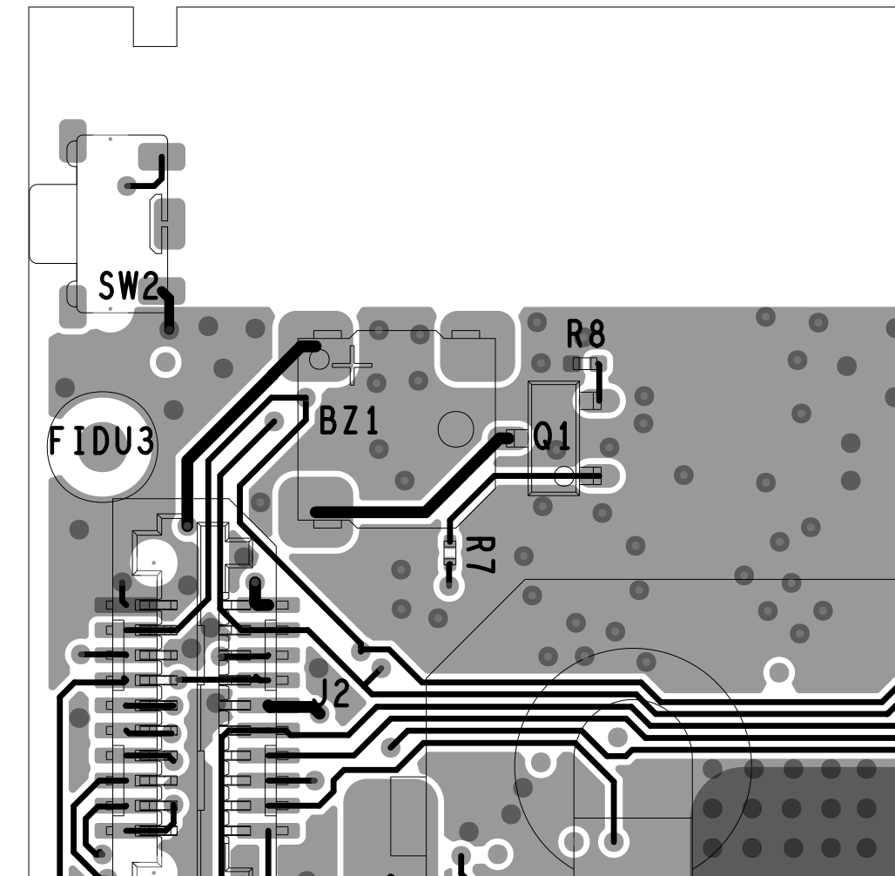
switch signal
switch
ground

